Slide 1
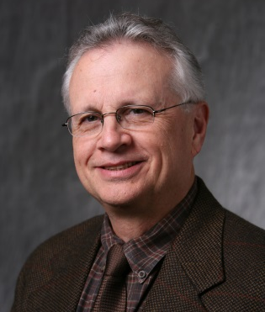
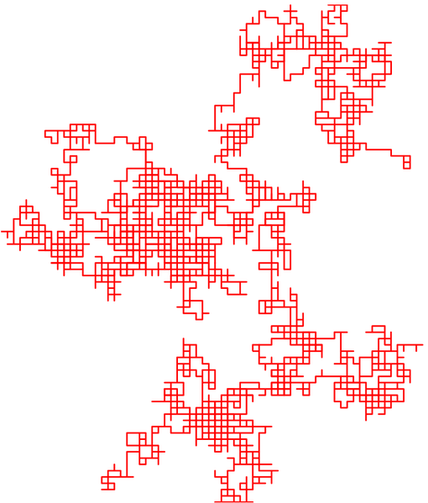
An EE’s journey
A Random Walk Thru Technologies, Opportunities and Tinkering
Background
Events
Programs
Influences
People
Lessons
Choices
Research
Leveraging Opportunities
??
Kenneth Connor
ECSE Dept
LESA ERC

Slide 2
Outline
Question: What Can You Learn from My Experiences as You Plan Your Careers?
Very Early Years
1957-58 – International Science
The Chosen
1963 – I Chose My Future
UW: Research, Internship, Professional Citizenship
UW: Grad School #1 & Poly: Grad School #2
RPI
& Tinkering

Slide 3
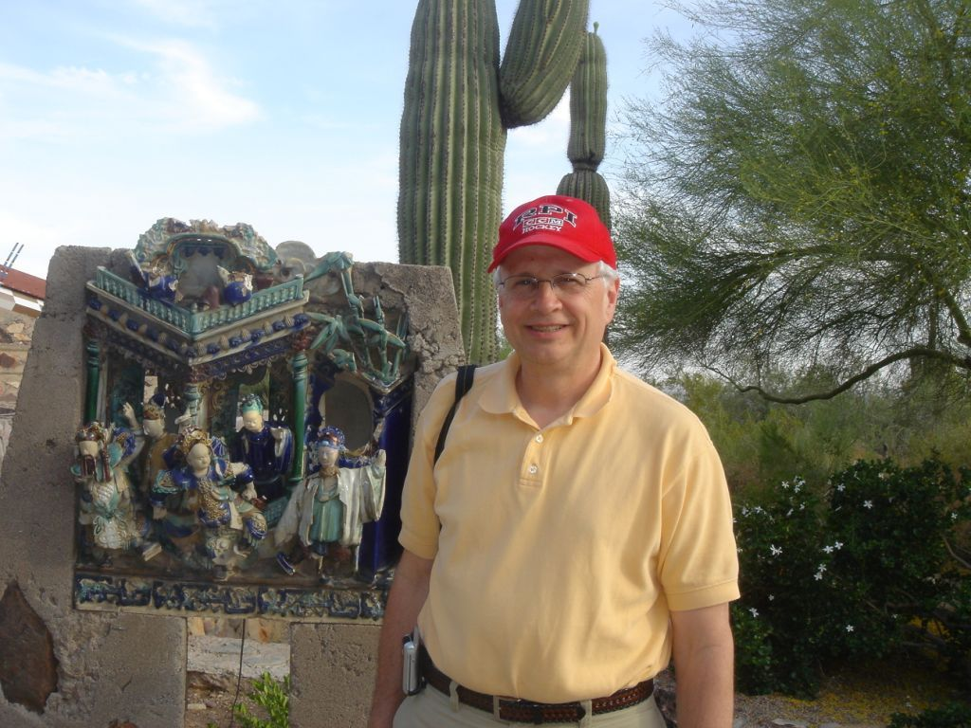
Who am i?
My Name is Ken Connor
I have been an ECSE Professor since 1974
Originally from Madison, Wisconsin
My family were dairy farmers until my parents’ generation.
My father Steve ran a gray iron foundry for a medium size machine tool company. He was ¼ Irish and ¾ German.
My mother Marie was a nurse. She was ¾ Norwegian and ¼ Danish.

Slide 4
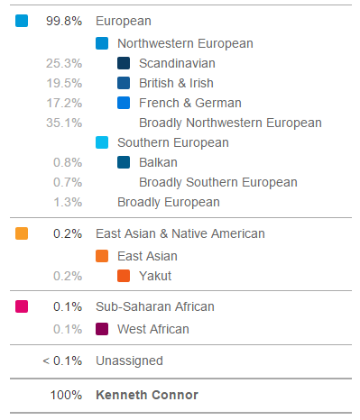
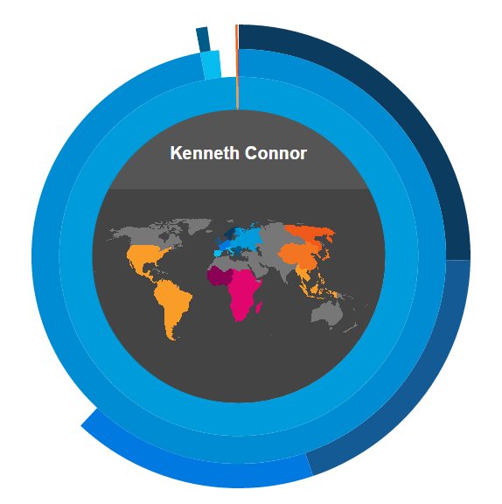
23ANDME

Slide 5
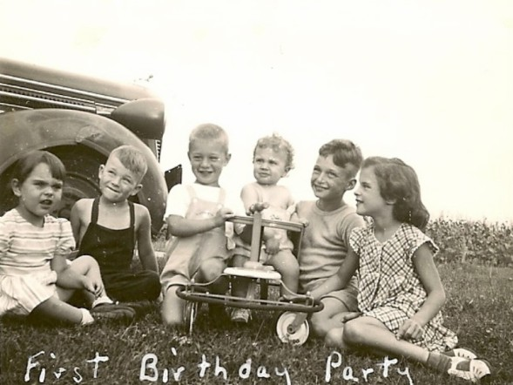
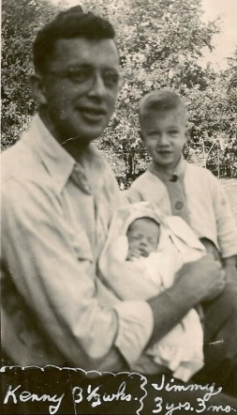
Who am i?
I Was Born as Soon as My Parents Could Manage after my Dad Returned from WWII

Slide 6
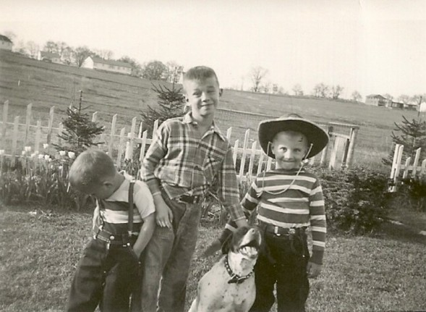
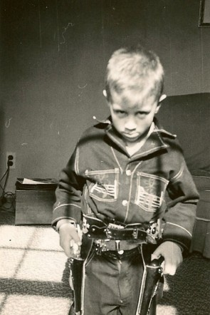
Who am i?
I Have Two Brothers
Jim
Dean
Flick

Slide 7
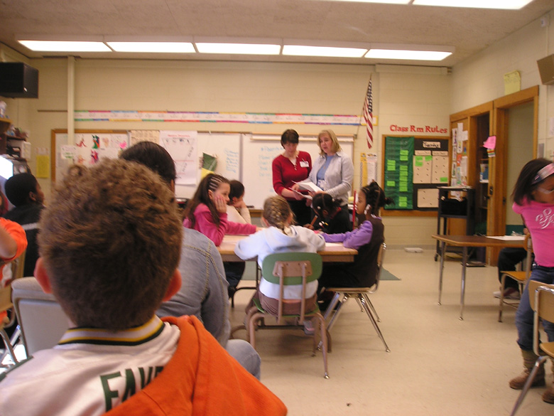
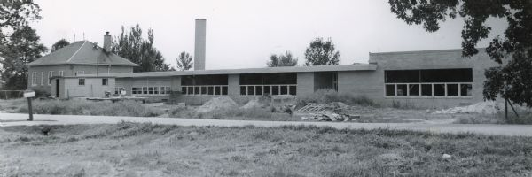
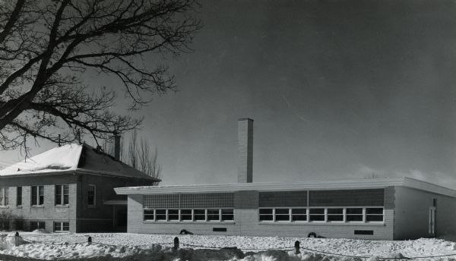
Who am i?
I Attended Mendota School from 1952-1958

Slide 8
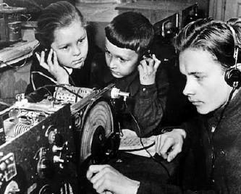
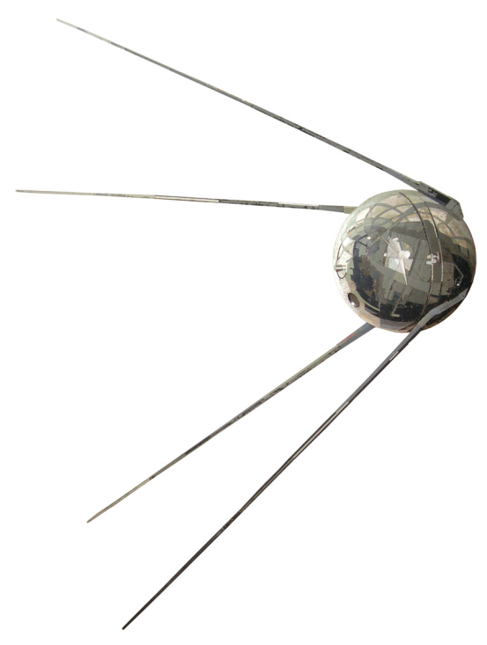
Why am I an engineer?
4 October 1957 – Sputnik 1 (Спутник-1)
6th Grade Class – 4 students selected for advanced studies
7th & 8th Grade Math & Science Combined
Began HS Math & Science in 8th Grade
Be Ready for Opportunities!
Diameter = 58.5 cm
Inside
Sounds
http://www.nytimes.com/interactive/2007/09/24/science/space/20070924_SPUTNIK_GRAPHIC.html#tab1
http://www.mentallandscape.com/Sputnik1_WashingtonDC.mp3
4 Oct – Between games 2&3 of Series

Slide 9
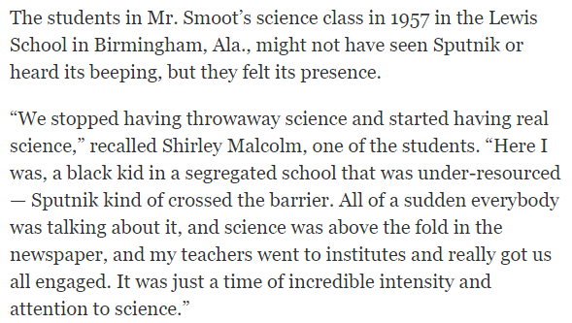
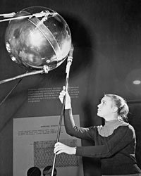
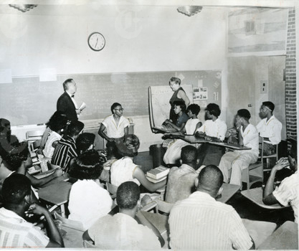
Sputnik Impact on Education
A Russian guide-engineer at a Moscow exhibition displays a replica of the Soviet satellite Sputnik 1, November 1957.
Bettman/Corbis
Broadcast at
20.007 MHz and 40.002 MHz
https://www.nytsyn.com/archives/photos/751637.html
http://www.nytimes.com/2007/09/25/science/space/25educ.html
http://www.npr.org/templates/story/story.php?storyId=14829195
Little Rock, Arkansas 1957

Slide 10
What is significant in these pictures?
Me
29 March 1958

Slide 11
Why am I an engineer?
?

Slide 12
Igy: International geophysical year
From Wikipedia:
International scientific project that lasted from 7-1-57, to 12-31-58 (After Josef Stalin’s death.)
67 Countries, 11 Earth sciences: aurora and airglow, cosmic rays, geomagnetism, gravity, ionospheric physics, longitude and latitude determinations, meteorology, oceanography, seismology, and solar activity.
Soviet Union and the U.S. launched artificial satellites. Van Allen Belt discovered. Plate Tectonics confirmed.
Science & Engineering Were Highest Priorities

Slide 13
Why am I an engineer?
Who was doing & who was watching?

Slide 14
Why am I an engineer?
In 6th Grade, I decided to become an EE
Good in math & science – become an engineer
I began playing with electronics, especially radios – EE
Why did I go to engineering school when none of the other three accelerated students from my elementary school did?
My theory – my dad was the ‘go to’ person for our extended family … if anyone had a problem they could not solve, they asked him to help. This made his sons problem solvers … it does not matter what the problem was, we do our best to find a solution.
Another theory – two were young women
Two became teachers … the other one???

Slide 15
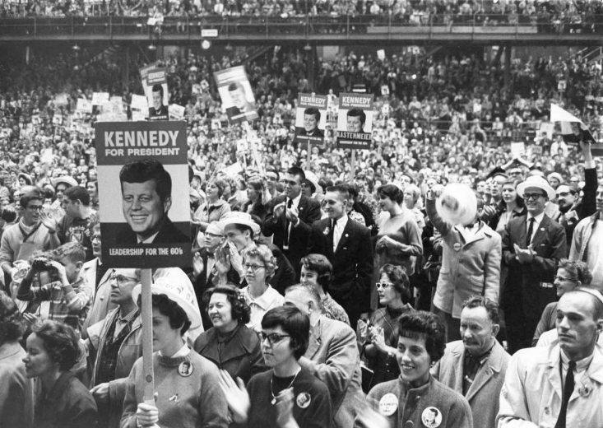
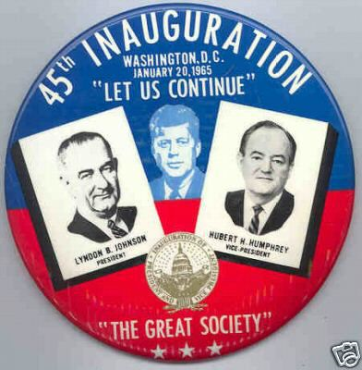
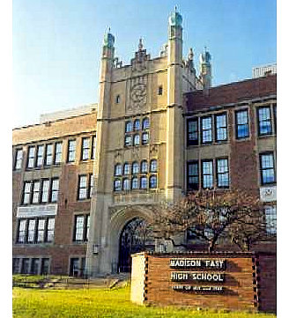
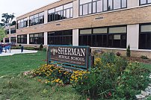
Who am i?
I attended Sherman Junior High School from 1958 – 1961
I attended East High School from 1961 - 1964

Slide 16
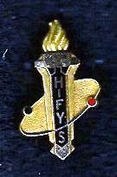
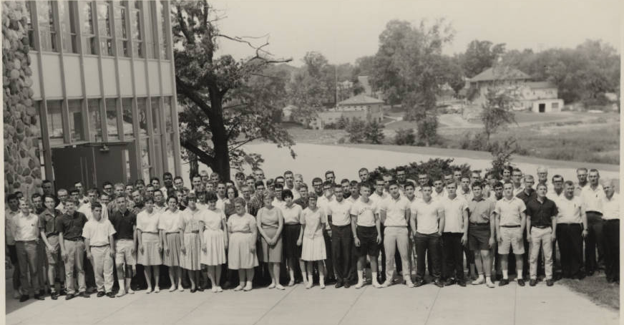
Why am I an engineer?
Honors Institute for Young Scientists: 8 Wks Summer 1963 (Grand Rapids & Ann Arbor)
Teachers were EE professors. I thought they had the coolest jobs. I decided to be one.
Going away and working with great students provides a calibration one cannot get at home.
Be Ready for Opportunities!
Math, Physics & Chemistry

Slide 17
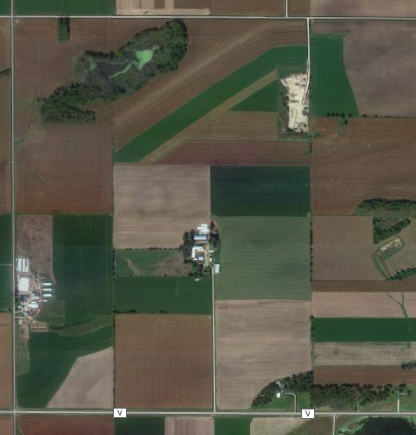
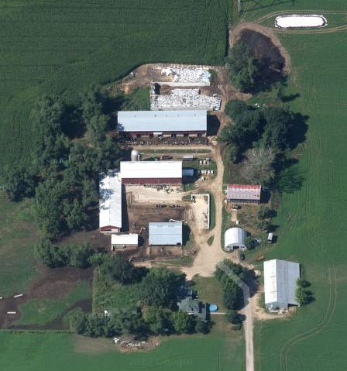
Who am i?
The Family Dairy Farm (Norway Grove, WI)
Not Included

Slide 18
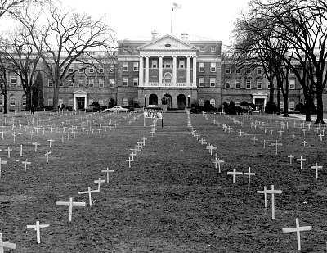
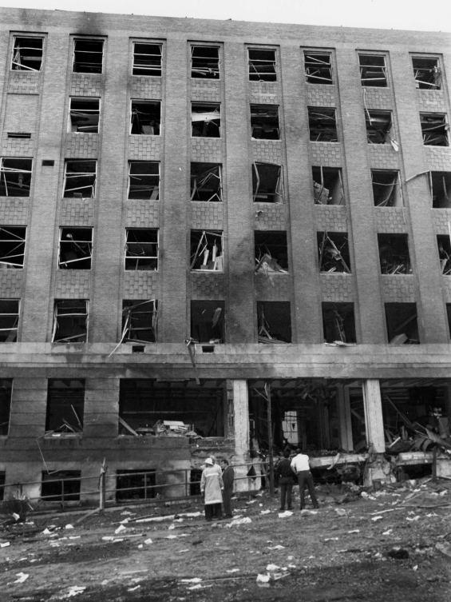
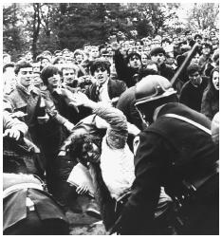
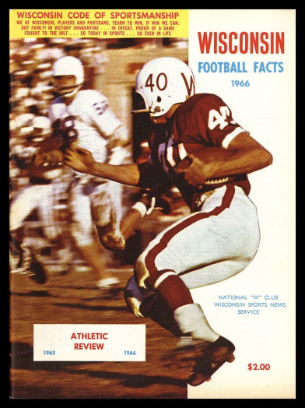
Who am i?
I Attended the University of Wisconsin from 1964-1970 Receiving 2 EE Degrees
Students Kidnap
Dow Recruiter
Physics Building Bombed
UW Football 11-45-3 during these years

Slide 19
Why am I an eE Professor?
Be Ready for Opportunities!
Key Events:
Many Part-Time Jobs
Professional Picket for Retail Clerks in 1965
Gisholt: I worked for my Dad in 1966
Solid-State Lab: I worked for 2+ years in a solid-state lab, assisting a grad student
John Deere: Summer Internship in 1967
HKN: I was very active in HKN leadership
Got to know many faculty
Identified the professor I wanted to do grad work with – Plasma Physics/Engineering

Slide 20
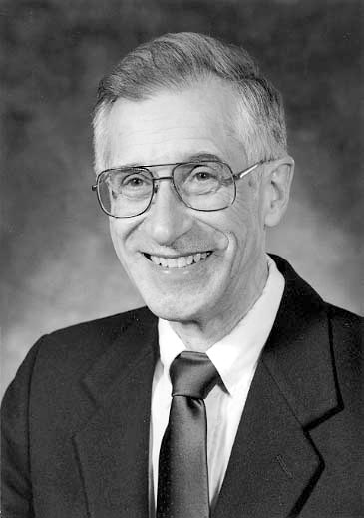
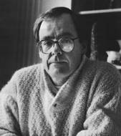
Why am I an ee professor?
Solid-State Lab, ECE Dept, Wisconsin
Prof. James Nordman
Semiconductors
Superconductivity
Prof. Alwyn C. Scott
Helped pioneer the understanding of nonlinear waves, emergent mental patterns and human consciousness
UW, Arizona, DTU, LANL …

Slide 21
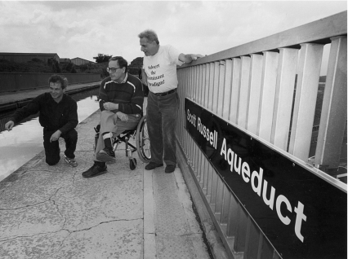
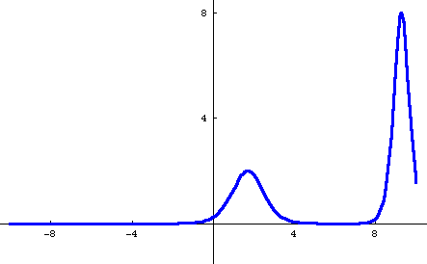
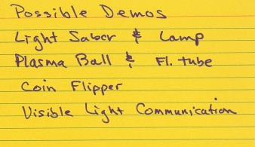
Why am I an EE professor?
Al Scott
A remarkable surge in the interest in solitons in biology occurred in the early 1970s because of two people: Alwyn C. Scott, a powerful theoretical physicist with a strong interest in nonlinear phenomena and biology, and Alexander Davydov, an eminent theoretical solid state theorist.
In 1834, John Scott Russell made the discovery of the wave of translation that gave birth to the modern study of solitons.
http://www.ncbi.nlm.nih.gov/pmc/articles/PMC2660402/

Slide 22
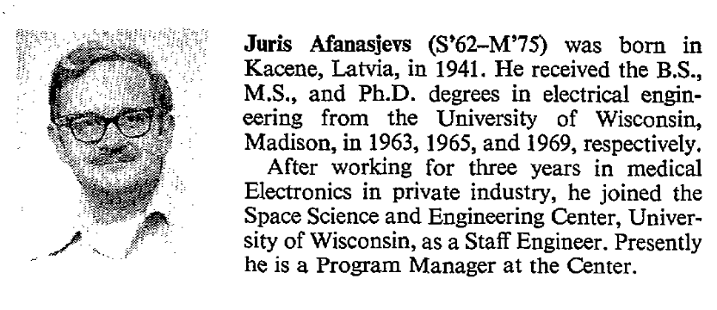
Who was the grad student?
Juris Afanasjevs
From 1976 IEEE Paper: No publications after that.

Slide 23
Why am I an ee professor?
John Deere Dubuque Works Internship – 1967
Goal: Experience the life of a BS engineer
What can one do with BSEE?
Being paid like an engineer.
Plant Engineering – Document power and control systems throughout plant
Mid-Summer Meeting – Report on summer
Research & Development – Front end loaders connected to RV full of instrumentation

Slide 24
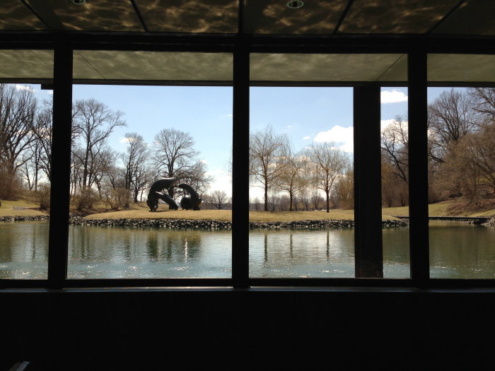
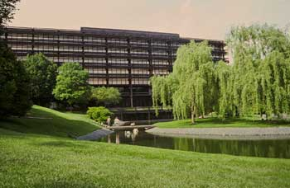
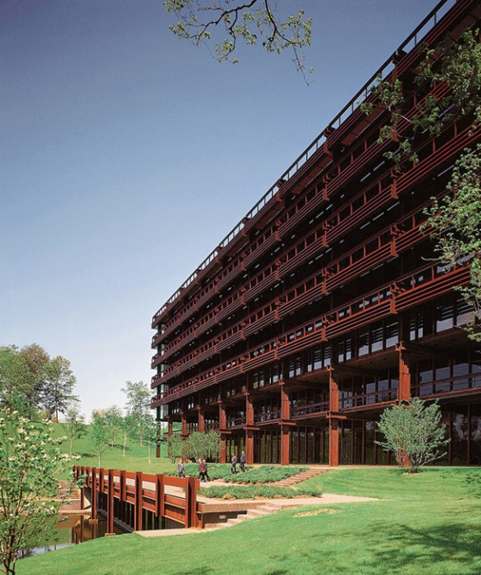
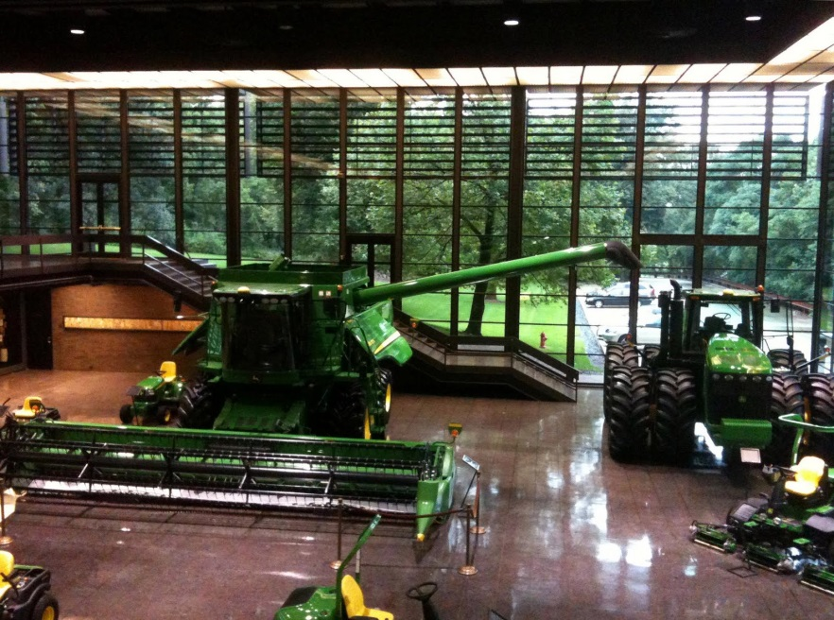
John deere world headquarters
Eero Saarinen

Slide 25
John Deere Dubuque works
What Did I Learn?
Engineer vs. Technician
Industry goal is to make money, not the best product.
Companies have cultures – AE & ME at JD
Don’t talk to management without preparation.
Big companies have a lot of money and amazing facilities.
I definitely wanted to go to grad school.
Be Ready for Opportunities!

Slide 26
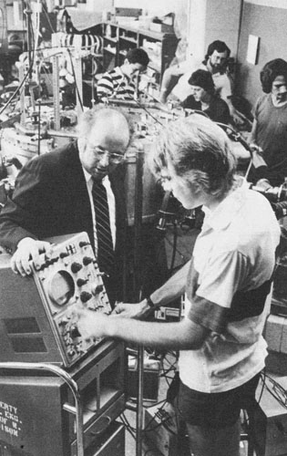
Why am I an ee professor?
HKN
Joined as junior, leadership as senior
Published Newsletter (ICBS)
Transient Controversy
Steady-State
Lessons/Benefits
Being known is good, bad writing is better than no writing
We used HKN to learn what we needed to know about grad school
Honorary societies are not just resume fillers, they are what you make of them
Found my first grad advisor – Prof. Leon Shohet
P. Hernday M. Vidyasagar

Slide 27
Research at Wisconsin
Off Resonant Microwave Heating of a Mirror-Confined Plasma
With J. Clint Sprott & J. Leon Shohet
Clint filled in for Leon while he was on sabbatical in France
Heating at 3GHz and 8.54GHz
Supported work that became the Elmo Bumpy Torus fusion experiment at Oak Ridge
Helped me decide that I was indeed an experimentalist, but I should have a solid theory background … decided to change schools.

Slide 28
What is a plasma & why do we care?
Plasma – Fourth State of Matter
Examples?

Slide 29
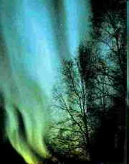
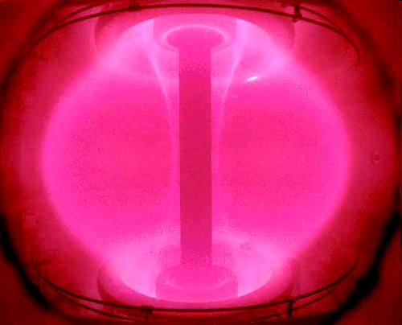
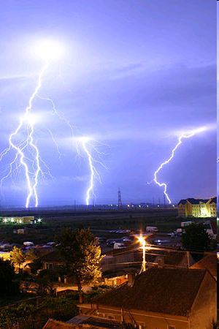
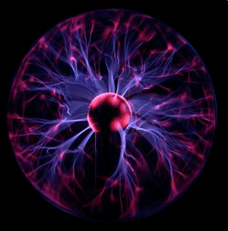
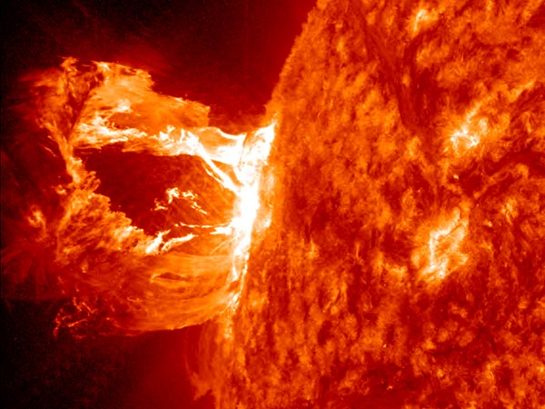
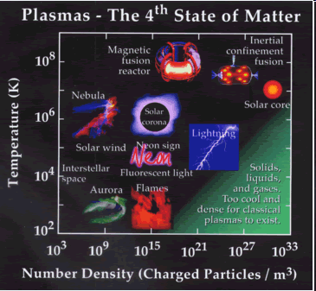
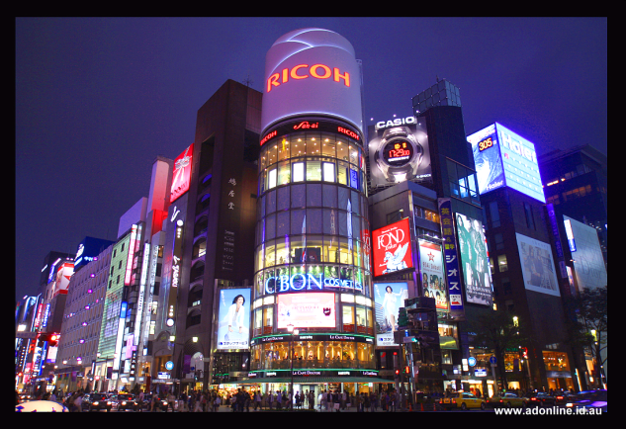
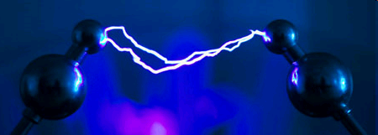
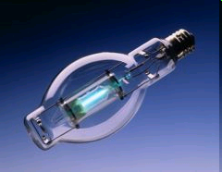
What is a plasma & why do we care?
http://www.plasmas.org/
http://www.plasmas.com/
http://en.wikipedia.org/wiki/Plasma_physics

Slide 30
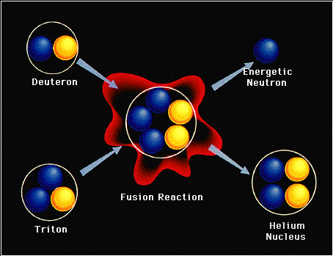
What is a plasma & why do we care?
Fusion
Potential energy
E_{n} = 14MeV
deposited in heat exchangers containing lithium for tritium breeding
Electrical repulsion
Total potential
E_{α} = 3.5 MeV
deposited in plasma, provides self heating
Energy Yield E_{F} = 17.6 MeV
Nuclear attraction
About 10 keV of kinetic energy is required to overcome the Coulomb barrier to obtain nuclear reaction
The nuclear interaction has short range whereas the Coulomb interaction is long range
The fusion reaction rate of an energetic T in a D target is much less than the energy loss rate due to Coulomb scattering
Plasma?

Slide 31
Nuclear fusion – Magnetic confinement
ITER
I have worked to help obtain controlled nuclear fusion since 1968
First Plasma is scheduled for December 2025

Slide 32
Fundamentals of Plasmas
Courses/Building Blocks (Examples)
Electromagnetic Theory
Statistical Thermodynamics, Kinetic Theory
Power, Electronics, Communications, Controls
Wave Phenomena (Linear & Nonlinear)
Instrumentation
Classical Mechanics
Numerical Methods
Applied Mathematics
To pursue a career in plasmas, I decided to build a foundation in electromagnetic theory in my doctoral studies. (Favorite Prof – S. R. Seshadri)

Slide 33
Why am I an ee professor?
Be Ready for Opportunities!
I attended the Polytechnic Institute of Brooklyn from 1970 – 1974 receiving a PhD in Electrophysics
I have been a professor of Electrical Engineering at Rensselaer Polytechnic Institute in Troy, NY since 1974.
http://kenconnor.org

Slide 34
research at poly
Thesis: Complex Space‑Time Rays and Their Application to Pulse Propagation in Lossy, Dispersive Media
Geometrical Optics (Ray Theory) is a powerful analytic approach to studying wave propagation.
Plasmas are lossy, dispersive media
My advisor (Leopold Felsen) was a leading expert on the waves of the electromagnetic spectrum, waves in water and other media. NAE member and fellow of many orgs … poet. A goal was to work for someone who was the world’s best.

Slide 35
Leo felsen
Poet’s Corner
EVANESCENT PROFESSORS
Occasions like the present one
Remind those who have come of age
That surely there will be a time
When they will move from center stage.
Just how a person leaves the stage
Is often difficult to say.
Old soldiers, getting to that point,
They never die, they Fade Away.
Professors somehow do the same.
How it is done, you’ll hardly guess.
For those of us who deal with Waves,
We do not fade, we Evanesce.

Slide 36
Research at rpi
Heavy Ion Beam Probing
Idea from Bob Hickok
Measurements: Potential, Density, Fluctuations
Napkin Science

Slide 37
HIBP
Really Big Voltmeter

Slide 38
HIBP

Slide 39
HIBP
ORNL: HIBP, ISX-B, ATF
Texas: TEXT, TEST-U
Wisconsin: MST
LLNL: TMX
MST
TEXT-U

Slide 40
Ebt & TEXT hibp
EBT
TEXT

Slide 41
Mst hibp
HIBP
Field Reversed Toroidal Pinch

Slide 42
HIBP at Wisconsin
Sterling & Chamberlin Halls

Slide 43
Other Research at RPI (Examples)
Electromagnetics
Magnetic Bearings (Tichy)
High Power Microwave Launchers (Salon)
Advanced Power Systems (Salon)
Force Sensors (Ledet)
Education
Project Links (Cast of 1000s)
Studio Instruction (Carlson, Maby, Schoch …)
Mobile Studio (Millard)
Flipped Classrooms (ERC, Newman et al)
Mobile Hands-On STEM (Meehan, Ferri, …)
Virtual Community of Practice (Huettel, …)
HBCU ECP (13 HBCU ECE Programs) … Also in Puerto Rico

Slide 44
Where has this work taken me?

Slide 45
Where has this work taken me?
Where are these buildings?

Slide 46
Where has this work taken me?

Slide 47
St. Petersburg

Slide 48
Where has this work taken me?
Notes:
Church of the Savior of the Spilled Blood

Slide 49
Where Has This Work Taken Me?
ORNL Y12
UT-Austin 1977
Notes:
ORNL
UT Austin in 1977

Slide 50
My brothers today
Tinkerers!
Metso Minerals Industries, Inc.
Mining Services North America

Slide 51
Opportunities Summary
New Programs
Coop/Summer Internship/Job
Undergrad Research – Academic & Summer
Technical/Professional Activities
Design Courses
Access to Tools
Access to Information from Instructors
Travel – Be Ready
Leverage Everything! Work with Others. Plan for the Future (Build Network/Relationships)

Slide 52
Questions?

